Slide 1
DIGITAL PORTFOLIO

Slide 2
ABOUT
STUDENT NAME: THAMIMMAJI M S
REG.NO & NMID:222403864/asunm293222403864
DEPARTMENT:BSC COMPUTER SCIENCE
COLLEGE NAME:VIDHYA SAGAR WOMEN’S COLLEGE

Slide 3
MY PORTFOLIO
BY
THAMIMMAJI M S

Slide 4
AGENDA
PROJECT OVERVIEW
END USE
TOOLS AND TECHNOLOGIES
PORTFOLIO DESIGN AND LAYOUT
FEATURES AND FUNCTIONALITY
RESULT AND SCREENSHOT
CONCLUSION
PROBLEM STATEMENT
GITHUB LINK

Slide 5
PROJECT OVERVIEW
The project focuses on creating a professional digital portfolio to showcase personal skills, projects, and achievements.
It aims to provide a user friendly and visually appealing platform for students and professionals.
The portfolio is built using modern web technologies to ensure accessibility across devices.
It helps user highlight their creativity, technical knowledge and career readiness in one organized space.

Slide 6
END USE
Can be used by students, job seekers, and professionals to showcase skills and projects.
Acts as a personal branding tool for internships, jobs, and academic opportunities.
Saves time by providing a centralized, easy-to-share profile.
Improves visibility and helps in better career opportunities and networking.
Enables continuous updates to keep achievements and skills current.
Supports cross-platform access, allowing anyone to view the portfolio anytime, anywhere.

Slide 7
TOOLS AND TECHNOLOGIES
Programming Languages – Python, Java, or C++ for developing the core logic.
Web Technologies – HTML, CSS, JavaScript for frontend development.
Database – MySQL / Mongo DB for storing and managing data.
Frameworks – Django, Flask, or React for building applications efficiently.
Tools – GitHub for version control, VS Code / PyCharm as IDE.
APIs & Libraries – Pandas, NumPy, Matplotlib for data analysis and visualization.
Cloud Platforms – AWS, Google Cloud, or Azure for hosting and deployment.

Slide 8
PORTFOLIO DESIGN AND LAYOUT
Clean & Modern Layout – Simple, professional design for smooth navigation.
Fully Responsive – Optimized for desktops, tablets, and mobiles.
Well-Structured Sections – About, Skills, Projects, Achievements, Contact.
Consistent Visual Style – Matching colors, fonts, and layout for a polished look.
Interactive Features – Clickable project previews, links, and contact forms.
Built with Modern Web Tech – HTML, CSS, JavaScript (with frameworks if needed).
Minimal yet Impactful – Highlights key strengths without clutter.

Slide 9
FEATURES AND FUNCTIONALITY
User-Friendly Interface – Easy navigation with clear structure.
Responsive Design – Works seamlessly on any device.
Secure Access – Optional login to manage and update content.
Dynamic Content – Add, edit, or remove projects and skills anytime.
Search & Filter – Quickly locate projects or achievements.
Customization Options – Personalize colors, themes, and layouts.
Error Handling – Proper alerts and validation for smooth user experience.

Slide 10
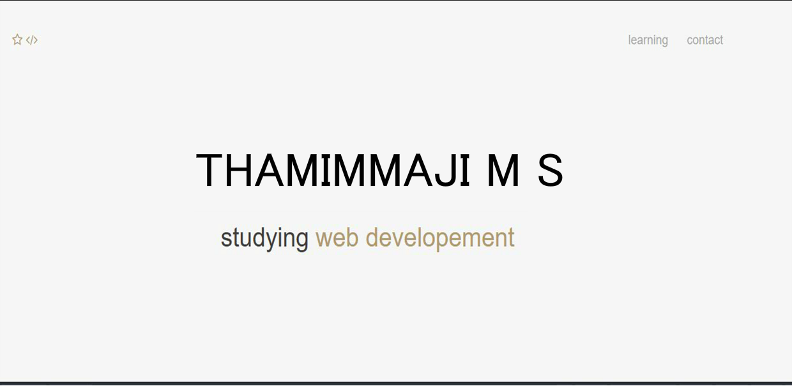
RESULT AND SCREENSHOT

Slide 11
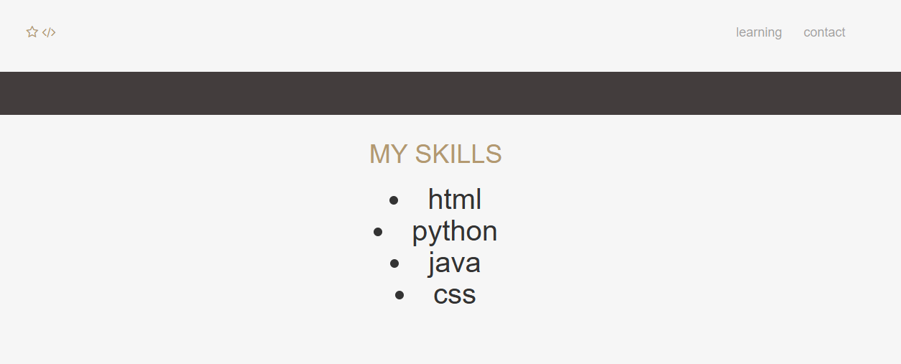
RESULT AND SCREENSHOT

Slide 12
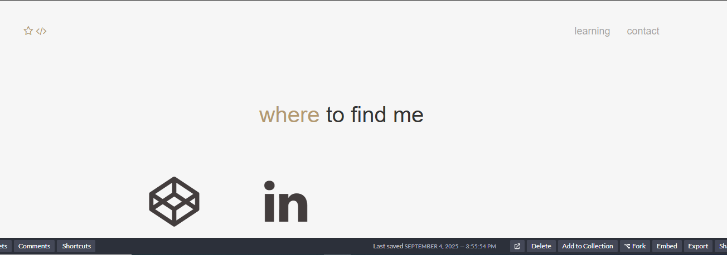
RESULT AND SCREENSHOT

Slide 13
CONCLUSION
Provides a professional platform to showcase skills, projects, and achievements.
Enhances career and academic opportunities through improved visibility.
Reflects personal growth, creativity, and technical expertise.
Offers a responsive, user-friendly, and easy-to-update design.
Acts as a powerful tool for building a strong digital presence in a competitive world.

Slide 14
PROBLEM STATEMENT
Background – Students and professionals need an effective way to present their skills online.
Problem – Many lack a professional platform to organize and showcase their work.
Impact – Missed opportunities due to unclear or outdated presentations.
Need – A simple, attractive, and accessible digital portfolio is needed now.
Scope – Provide a responsive, easy-to-update platform to highlight skills and projects clearly.

Slide 15
GITHUB LINK

Slide 16
THANKING YOU

